Slide 1
Leather Shoe Demo
Product Demo Setup

Slide 2
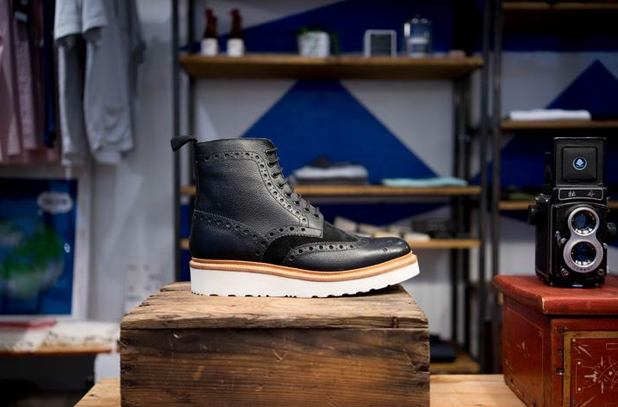
Leather Shoes
Leather Boot _ options
Leather upper (holes match leather)
3-5 colors (tbd)
Laces
3-5 colors (tbd)
Suede upper
3-5 colors (tbd)

Slide 3
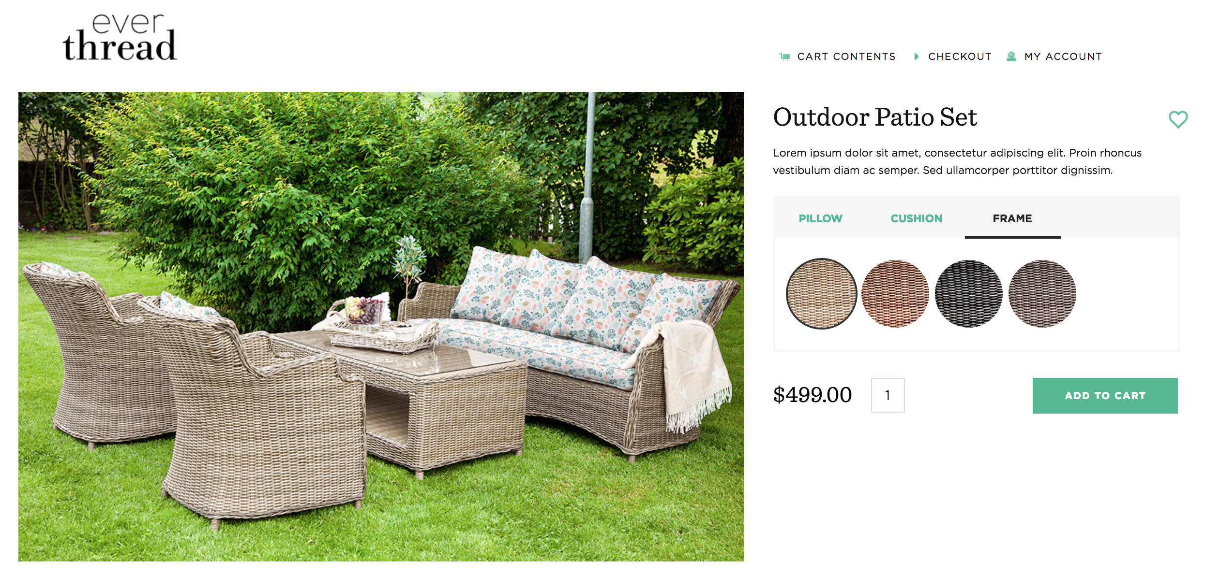
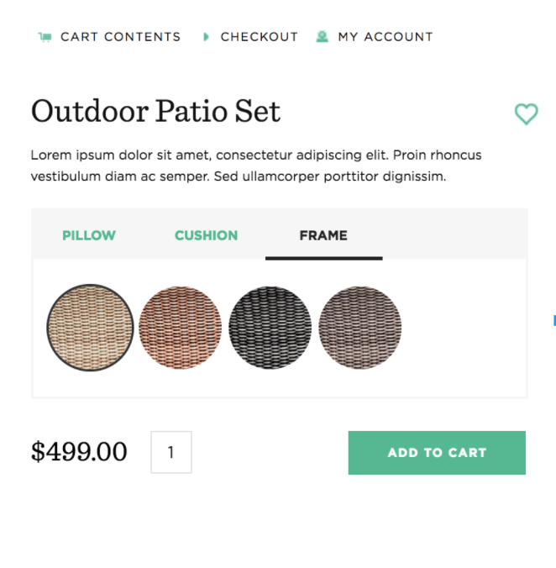
Demo page layout
Page Setup: This is the page layout that needs to be created for this demo. Please follow the styling and functionality of the everthread.com/outdoor demo page. For now this demo can sit outside of the EverThread sandbox store on a heroku server just like the polo demo. Please be sure our logo and other non functioning items are on the page. Logo File is here , let me know if you need a different size
These need to be on the page
Men’s Leather Shoe
Leather Suede Laces
Options: please set these up to work just like the everthread.com/outdoor demo
Colors: Robert has set these up similarly to the men’s polo shirt. For product and color information please see this google doc: https://docs.google.com/spreadsheets/d/1toxIQBXoWaWdIfbej-e4BhUg2VEgI76ulz_3uTR5ZPU/edit?usp=sharing
All IDs are listed for this image are listed under Men’s Leather Shoe. There are 3 color options for each item (Leather, Suede, Laces)
1
2
3
These do not need to be on the page

Slide 4
Configuration tool
Options configuration tool: please set these up to work just like the everthread.com/outdoor demo. Meaning as you click on the word “Leather” all of the leather colors appear, and when you click on “Suede” all of the Suede colors appear, etc…
Colors: all of the corresponding colors can be found in this spreadsheet. Robert set up each of these items and will be able to answer any questions related to the images, colors and ID codes.
Each of the circles should be filled with a HEX code color that Robert has assigned for that item option.
The 1 position for all options should be the original color the product came in in the original image. (Robert will be noting this in the spreadsheet)
These are also the colors that I would like the image to open with when you open the page.
Leather Suede Laces
1
2
3

